Slide 1
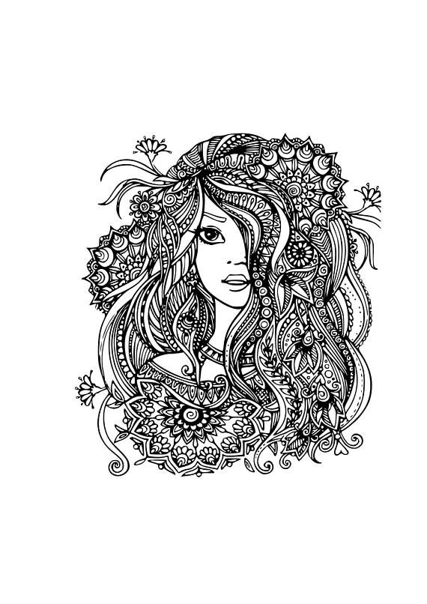
gTangle
A Grammar for the Procedural Generation of Tangle Patterns
Lab Team
Aman Goel
Ammar Ahmed
Aryamaan Jain
Jyoti Sunkara
Mentor
Prajwal Krishna Maitin

Slide 2

Tangles are a form of two dimensional structured pen and ink art created by a small set of basic strokes:
Dots
Straight Lines
Curves
Shapes
Notes:
A tangle pattern is a beautiful, interwoven tapestry of basic stroke patterns, like dots, straight lines, and simple curves. If we look at some of these works, we see that many of these are highly structured, and maybe, we could automatically create such beautiful structures with a computer! This piece of work is about generating Tangle patterns with grammars.
Their complexity comes from the repetition of those strokes, to form structured patterns drawn recursively at different scales.

Slide 3
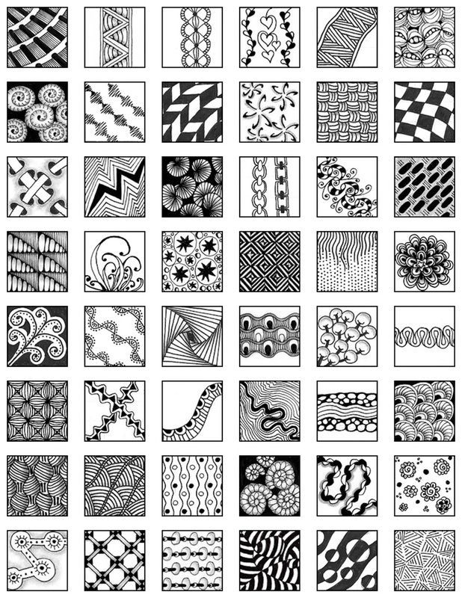
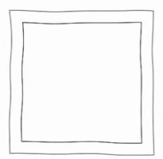
The tangles are generated by recursively splitting and combining initial set of polygons, using group grammars that perform operations on the polygons.
Notes:
The three types of operators are combined in a meaningful manner: Grouping, Geometric and Decorative!

Slide 4
Purpose
Artistry
Tangles take artists hours of tedious and time-consuming work which can now happen quicker and with fine control.
03
Group Grammars Simplicity
Expressing complex tangles patterns and sub-pattern distributions, with relatively simple grammars.
01
02
Speed
Group grammars can, in few tens of seconds, produce a wide variety of patterns!

Slide 5
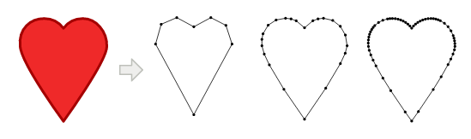
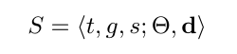
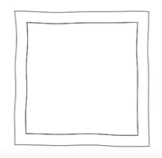
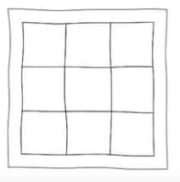
Grammar
Shape
Geometric Shape
Grammar Shape
Rules
Regular Split Rule
General Production Rule
Notes:
Grammars are a set of rules that tell us how to build up a structure, such as a sentence properly from small elements, like nouns, adjectives, pronouns, and so on.
Grammars have set up rules that enforce that every mathematical expression satisfies a number of desirable constraints.
Grammar are a way to mathematically simplify the most complex structures existing. Especially given the fact that from grammars, we can build not only sentences, but buildings. For instance, a shape grammar for buildings can describe rules like a wall can contain several windows, below a window goes a window sill, one wall may have at most two doors attached, and so on.
For the purpose of this paper every geometric shape is arbitrary 2D polygons with holes, where their boundaries are represented as highly-tessellated closed curves.
Each shape is represented as a tuple <t, g, s> where t is the shape tag, g is the group id and s is the shape id. Its additional attributes Θ, the list of curves describing the boundary of the polygon, and a unit vector d, that defines the orientation of the shape are used for drawing the SVG
In group grammars, a production R is expressed in the following form where O is the tangle operator that will be used when the rule is applied, {p_{o} } the operator parameters, t_{m} is the tag that will be used to select the matching shapes

Slide 6
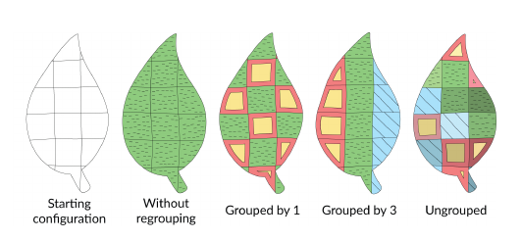
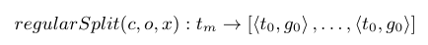
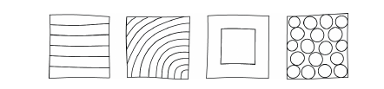
Operators
Grouping Operators
Grouping Operators Geometry
Geometric Operators
Geometric Operators Geometry
Notes:
The operators applicable during the expansion process are subdivided into three main categories:
(1) grouping operators, that don’t actually modify any shape, but only re-label sets of shapes by manipulating their group and shape ids
(2) geometric operators, that subdivide shape groups by splitting, outlining and placing objects in them
(3) decorative operators that simply modify the final appearance of a shape
Filling that sets the background color of a shape and
Stippling that stipples the shape with geometrical details like dots, dashes, curves
These mathematical hieroglyphs represent the operations that can be performed on the shapes!

Slide 7
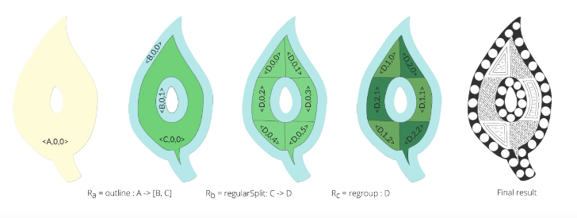
Recursive Operators
Notes:
In this piece of work, we start out with an input shape, subdivide it into multiple other shapes, assign these smaller shapes into groups.
And the final tangle is obtained by choosing patterns and assigning them to all of these groups.
This yields a very expressive, powerful, tool that anyone can use to create beautiful tangle patterns. And all this, through the power of grammars!

Slide 8
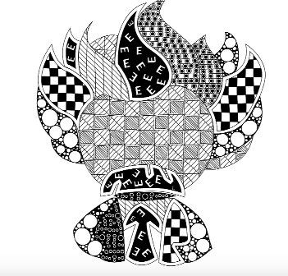
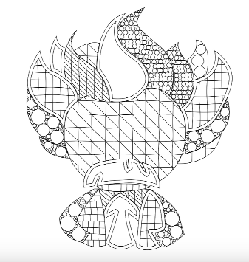
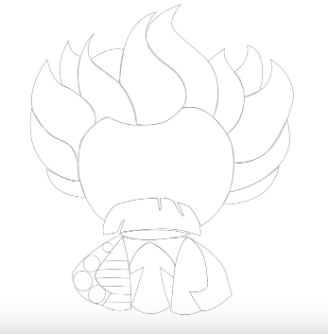
Iteration
Shape Perturbation
A coherent noise function that is applied to all shapes with the same group id
2
Decorative Operators
The shapes are filled and stippled
5
111
1
4
Grouping And Geometric Operators
The shapes are grouped, split, placed and outlined
3
Tree
The SVG is stored as a tree data structure after being bisected into the elemental structures
Input
An outline sketch in SVG format is provided as input
Or an SVG outline is created by us.
2
1
2
Notes:
Tangles are drawn completely free-handed. To simulate the organic feel of our generated tangles, we apply a perturbation for all subdivided shapes. Since we are dealing with adjacent close polylines, meaningful intersection points and shape adjacencies might be invalidated if perturbation is done improperly.

Slide 9
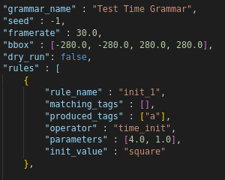
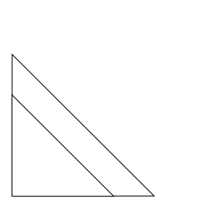

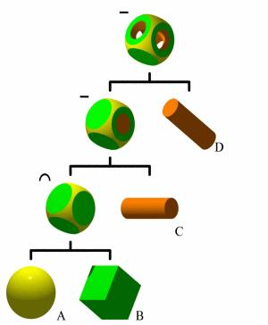
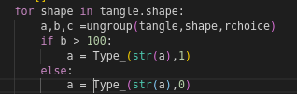
Results
JSON
SVG Drawing
Constructive Solid Geometry Tree Data Structure
Grouping Operators
Notes:
Constructive Solid Geometry trees are binary trees where each level can be expressed as a union, intersection, sum, difference or XOR of its leaf nodes.

Slide 10
Challenges
Challenge 1
Challenge 2
Challenge 3
Collaboration
With the online semester underway the difficulty of communication, debugging, pair programming and explaining code has become manifold.
SVG Graphics
SVG defines the graphics in XML format.
The intricacies of SVG images, how they are drawn, stored structured and created and how to create them from code are all new problems for us.
Constructive Solid Geometry Trees
While grammars bring mathematical finesse to the tangles on paper. The representation and manipulation of shapes using a graph in code is a hard problem to solve.

Slide 11

Progress
Grammar tree data structure to store shapes and take tessellated polygons as input and output in SVG format
Structuring rules as JSON files and parsing them
Grouping Operators
Overall:
43%
Completed!

Slide 12

Road Ahead
We are here!
Proposal Submission
Reading related papers and literature review
Structuring the grammar as a tree
Reading and parsing rules as JSON objects
Grouping Operators
Geometric Operators
Decorative
Operators
Shape Perturbation
Testing And Creating Tangles!

